Slide 1
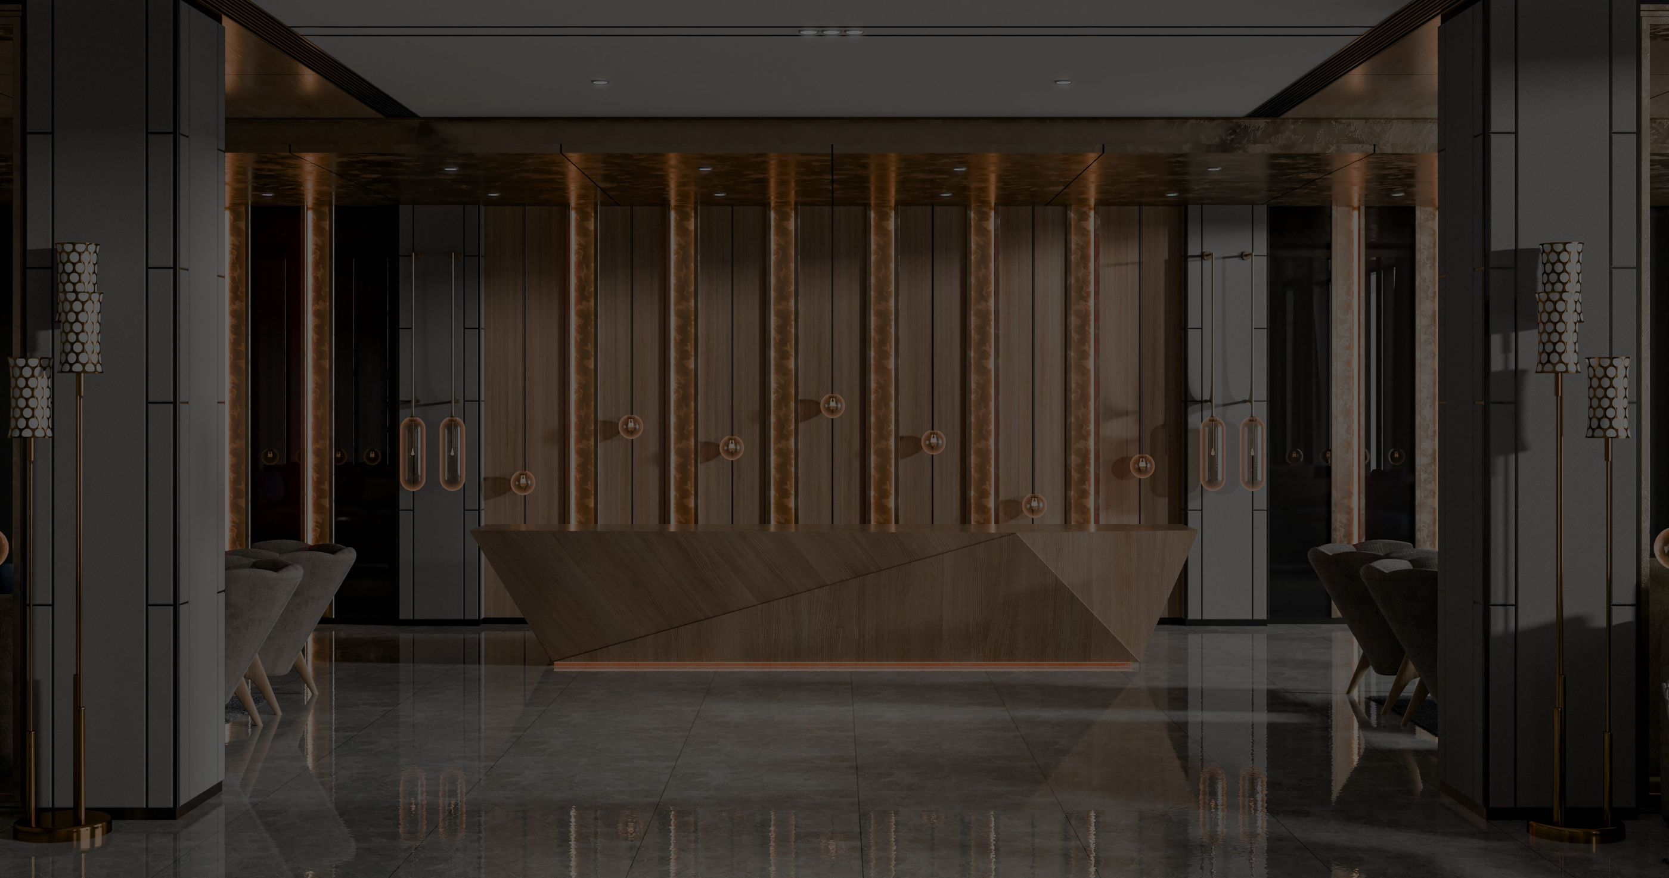

REVIEW MANAGEMENT SYSTEM
github repo link
FT. MARRIOTT INTERNATIONAL
Where Feedback Becomes Foresight
Presented by
404 FOUND

Slide 2



Presented by
404 FOUND
PROBLEM STATEMENT
FRAGMENTED FEEDBACK SOURCES
Reviews are scattered across multiple platforms with no unified dashboard for real-time monitoring.
Multi-branch organizations receive large volumes of customer reviews across internal systems and third-party platforms like Google and Zomato, but the absence of a centralized and structured review management system leads to fragmented visibility, delayed responses, and limited insight into branch-level performance.
LACK OF STRUCTURED INSIGHTS
Unstructured feedback makes it difficult to categorize issues (service, food, staff, ambience) and identify recurring operational gaps.
DELAYED ACTION & PERFORMANCE BLIND SPOTS
Inconsistent responses and absence of branch-wise or staff-wise analytics prevent timely intervention and performance improvement.

Slide 3
Presented by
404 FOUND
WHY EXISTING SOLUTIONS FAIL
Siloed Monitoring Instead of True Integration
Many tools still rely on partial integrations, leaving reviews scattered across internal systems and third-party platforms without complete, unified visibility.
Surface-Level Analytics
Existing solutions often provide basic sentiment scores but fail to deeply structure feedback into actionable operational categories, making recurring issues difficult to detect.
Reactive Rather Than Proactive Systems
Most platforms focus on responding to reviews rather than identifying patterns early, leading to delayed action and limited branch-wise performance insights.
Testimonials

Slide 4
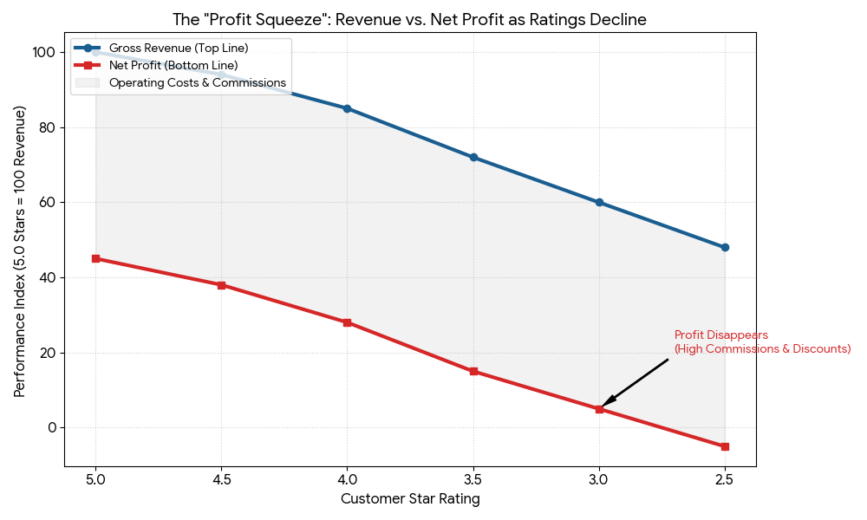
Presented by
404 FOUND
REAL-TIME SCENARIO
The 4.0 "Breakeven" Baseline: For premium brands like Marriott, dropping below 4.0 stars triggers a compounding negative financial effect.
The Penalty Curve: Moving from 4.0 to 3.0 stars causes a sharp 11.5% drop in occupancy. Guests penalize negative ratings far more than they reward positive ones.
Double Revenue Loss: As ratings fall, revenue (RevPAR) drops 10% per star. This is a "double hit": fewer guests (occupancy) and lower prices (ADR) to stay competitive.
Critical Risk Zone: Below 3.5 stars, a branch loses all "Pricing Power." It can no longer justify premium rates, causing profit margins to collapse.

Slide 5
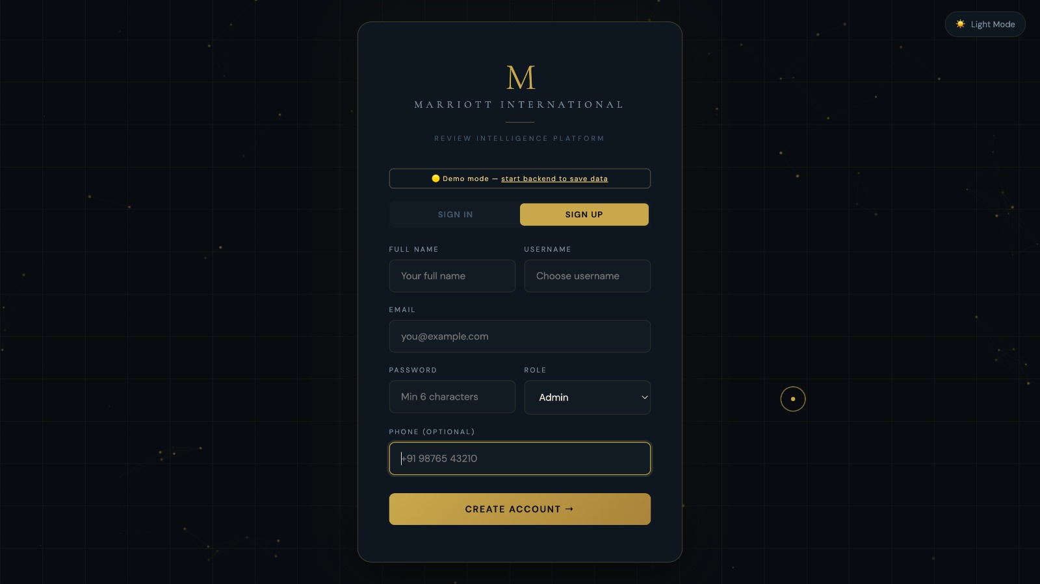

Presented by
404 FOUND
OUR SOLUTION
Our solution is a centralized review intelligence system built using Marriott International as a case study and real-world data from platforms like Google, TripAdvisor, and MakeMyTrip. It aggregates scattered reviews into a single interface and categorizes them to uncover branch-level operational issues. Rather than focusing on marketing, established hotel chains need insight into why ratings fall. Our model identifies recurring problems within specific properties, turning unstructured feedback into actionable intelligence so brands can address internal gaps, protect ratings, and maintain competitive strength.

Slide 6
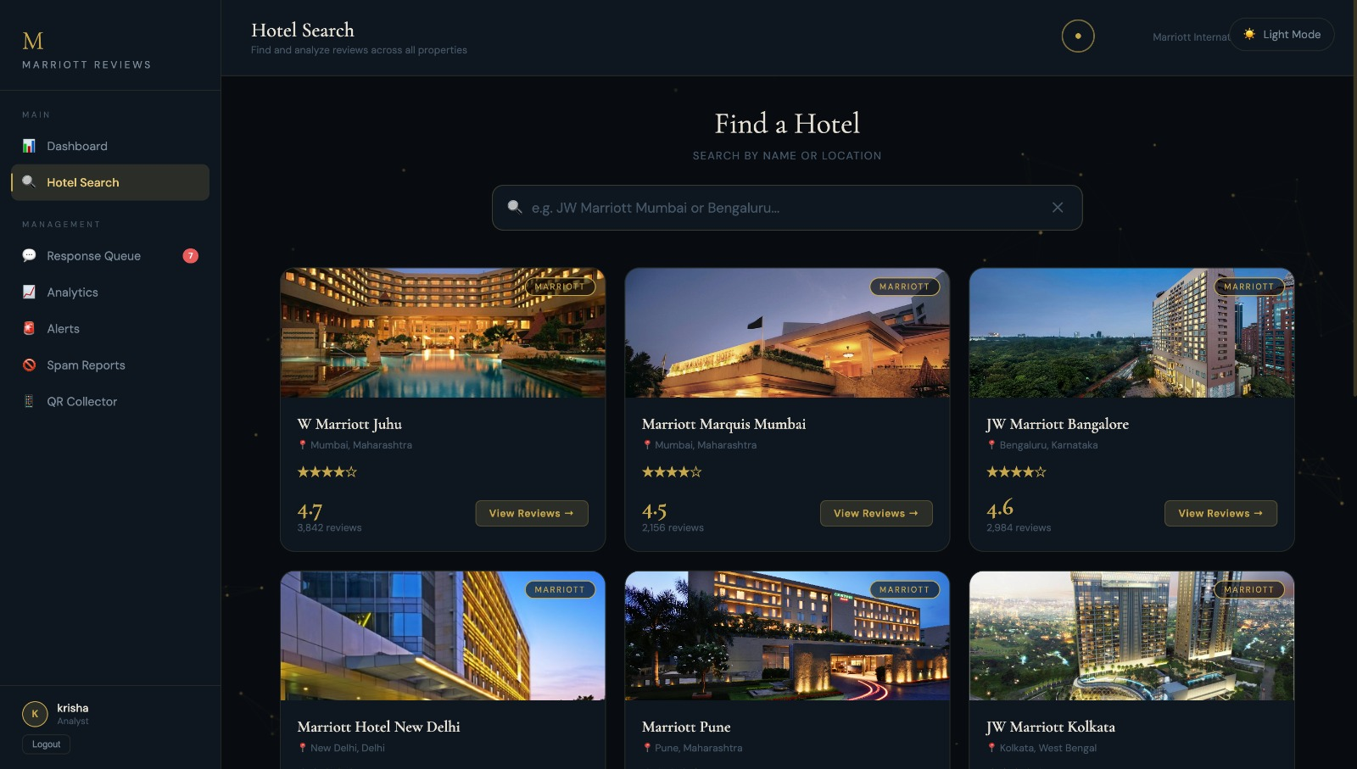
INTERFACE

Slide 7
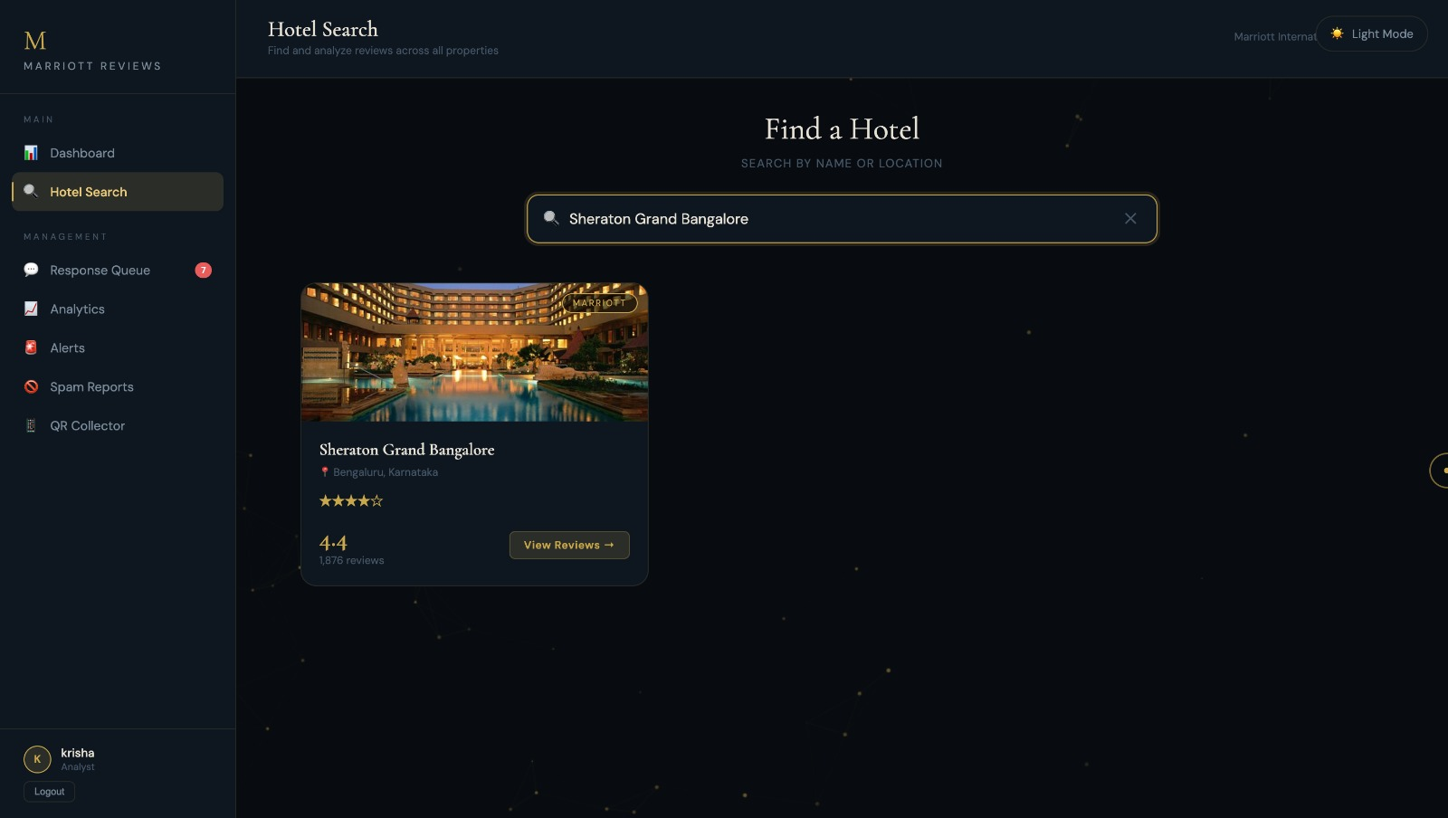
INTERFACE

Slide 8
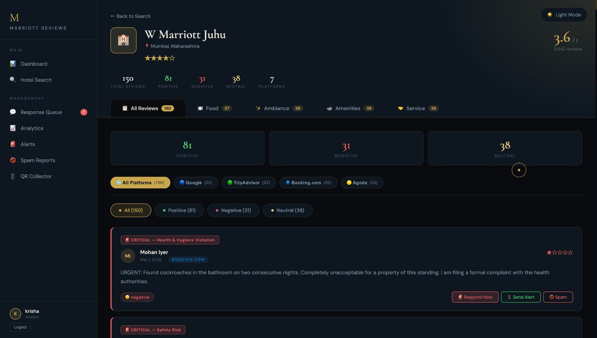
Presented by
404 FOUND
HOTEL SEARCH

Slide 9
Presented by
404 FOUND
HOTEL SEARCH
CATERGORIZE DATA

Slide 10
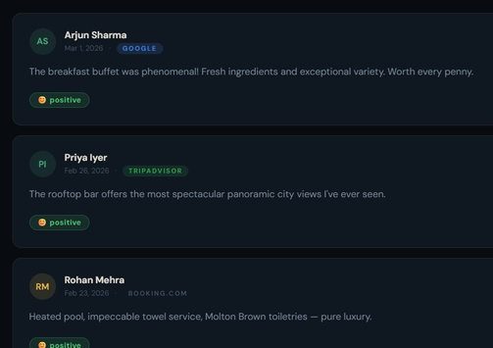
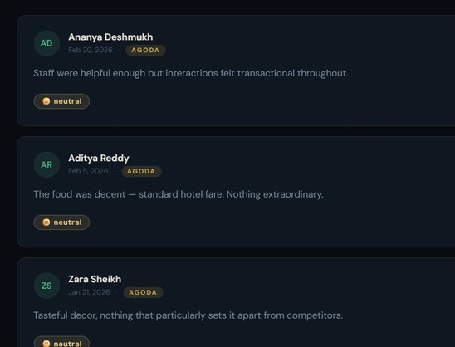
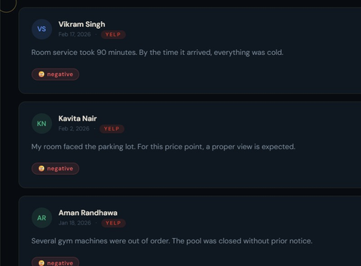
Presented by
404 FOUND
SUBREVIEWS
POSITIVE
NEUTRAL
NEGATIVE

Slide 11
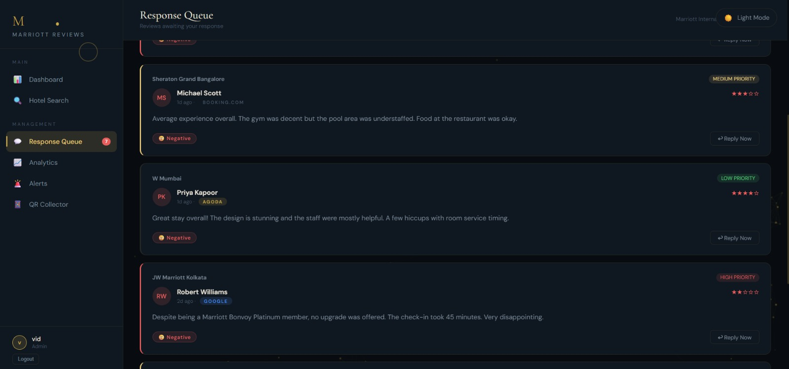
Presented by
404 FOUND
RESPONSE QUEUE
Catergozises negative reviews as high, medium and low priority to be solve

Slide 12
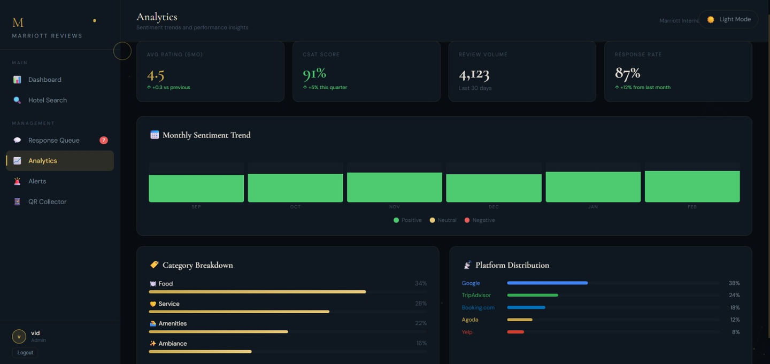
Presented by
404 FOUND
ANALYTICS
Gives number of reviews in each catergory
It gives the platforms from where we have actually collected the data.

Slide 13
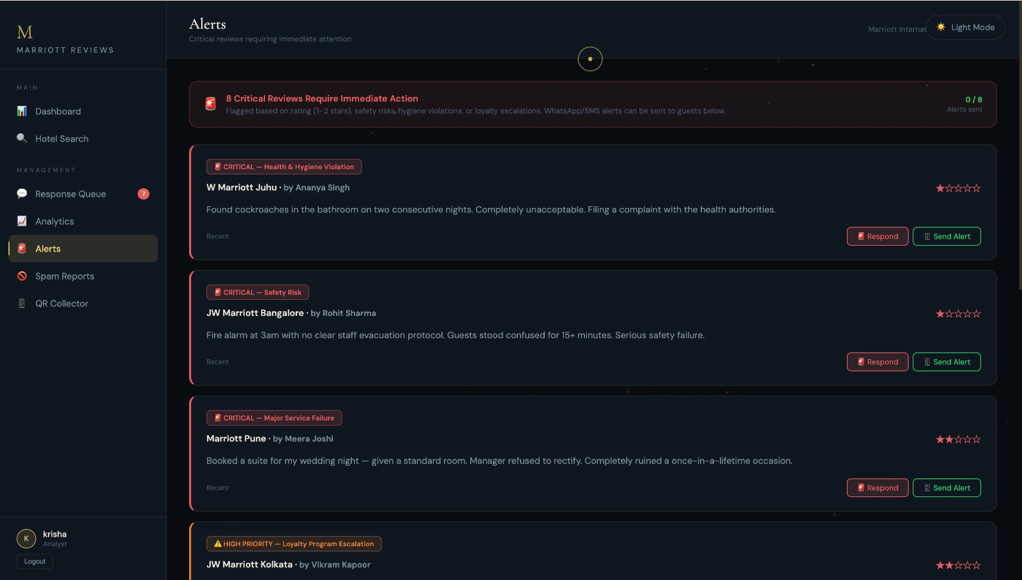
Presented by
404 FOUND
ALERT

Slide 14
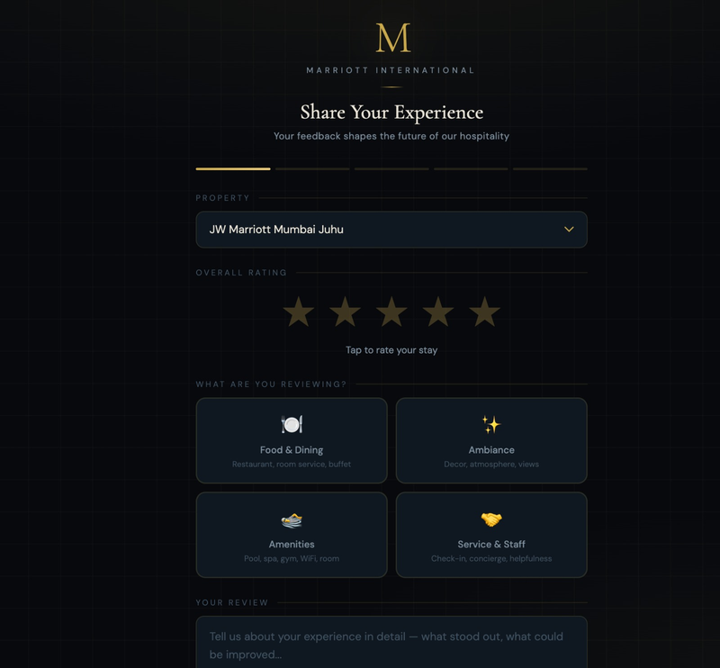
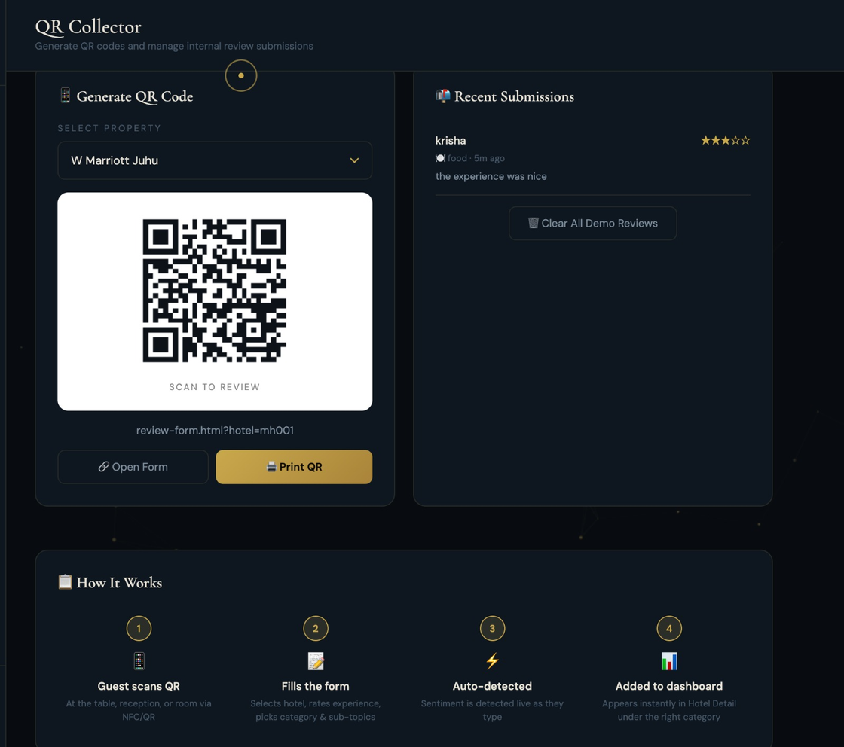
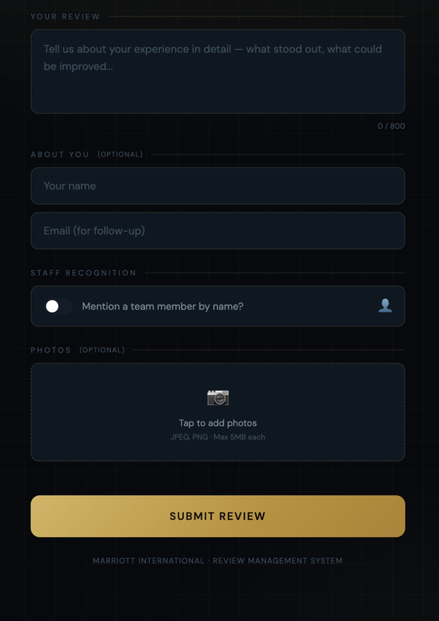
Presented by
404 FOUND
FORMS
QR TO SCAN

Slide 15
THANK YOU!!!

